Slide 1



Overview of the Database Management System Session No.: 1 Course Name: Database Management System Course Code: E2UC302B Instructor Name: Dr. Pawan Kumar
Galgotias University Students-Centred Active Learning Ecosystem

Slide 2
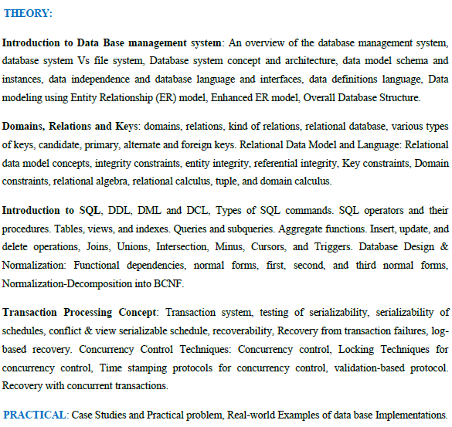
COURSE CONTENT
Galgotias University Students-Centred Active Learning Ecosystem

Slide 3
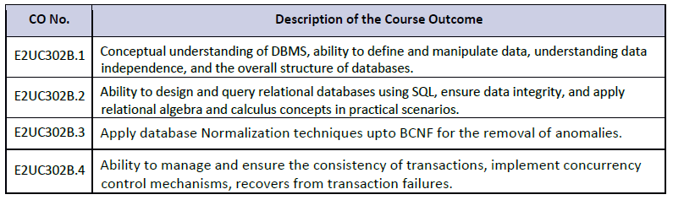
COURSE OUTCOMES
Galgotias University Students-Centred Active Learning Ecosystem

Slide 4
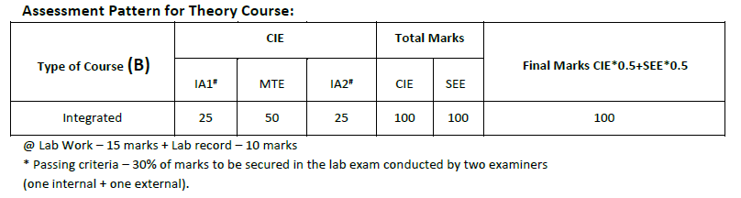
ASSESSMENT PATTERN
Galgotias University Students-Centred Active Learning Ecosystem

Slide 5


Where do you encounter databases in your daily life?
Galgotias University Students-Centred Active Learning Ecosystem

Slide 6
At the end of this session students will be able to :
LO1: Explain the purpose of a DBMS.
LO2: Explain the key functions of a DBMS and the importance of databases in everyday life.
Galgotias University Students-Centred Active Learning Ecosystem
03.03.2025

Slide 7
Session Outline
1 Introduction
2 Purpose
3 Applications
4 Significance
Galgotias University Students-Centred Active Learning Ecosystem

Slide 8
Introduction
DBMS: is a collection of interrelated data and a set of programs to access and manage that data.
Database: is the collection of data, and the DBMS is the software that helps in storing, retrieving, and manipulating the data.
Goal: Store & retrieve data conveniently and efficiently
Ensures:
Safe storage
Efficient access
Data sharing without anomalies
Galgotias University Students-Centred Active Learning Ecosystem

Slide 9
Characteristics of a DBMS
Handles large volumes of information.
Provides data structures for storage and mechanisms for manipulation.
Ensures data safety and security, even during crashes or unauthorized access attempts.
Supports multi-user access while preventing anomalies.
Reduces data redundancy and ensures data integrity.
Galgotias University Students-Centred Active Learning Ecosystem

Slide 10
Why DBMS?
DBMS arose to overcome problems with file-based systems used earlier.
In traditional file systems:
Data redundancy and inconsistency.
Difficulty in accessing data.
Limited security and integrity.
New applications required new programs.
DBMS solves these issues by:
Centralized storage and control.
Efficient data retrieval and updates.
Security and access control.
Easier integration of new applications.
Galgotias University Students-Centred Active Learning Ecosystem

Slide 11

Learning Activity 1: Case Study (use wooclap)
Roll_No Name Age Email201 Anu 19 anu@gmail.com202 Ravi 135 ravi@gmail.com203 Meera 21 meeragmail.com
Answer:
Age 135 → Out of domain.
meeragmail.com → Invalid email format (violates domain constraint).
Assign the case study examples (e.g., airline ticket booking, online banking, or university course registration).
Identify how databases are used, what kind of data is stored, and what problems a DBMS helps to solve.
Galgotias University Students-Centred Active Learning Ecosystem

Slide 12
Applications of Database Systems
Enterprise Information :
Sales: Customer, product, purchase info.
Accounting: Payments, receipts, account balances, assets.
HR: Employee info, salaries, payroll, benefits.
Manufacturing: Supply chain management, production tracking, inventory.
Online Retailers: Order tracking, recommendations, product reviews.
Banking and Finance :
Banking: Customer accounts, loans, transactions.
Credit Cards: Purchases, monthly statements.
Finance: Holdings, stock trades, real-time market data.
Galgotias University Students-Centred Active Learning Ecosystem

Slide 13
Applications of Database Systems
Universities:
Student data, course registration, grades, transcripts.
Airlines:
Reservations, flight schedules, distributed access to data.
Telecommunication:
Call records, billing, prepaid card balances, network information.
Galgotias University Students-Centred Active Learning Ecosystem

Slide 14
Evolution of Database Systems
Early Days: Users interacted indirectly (credit card statements, bank tellers, airline agents).
Later: ATMs and phone-based systems gave direct access to databases.
Internet Revolution (1990s):
Web interfaces allowed customers direct access.
Online shopping, banking, and entertainment became database-driven.
Today: Almost every app/service (Amazon, Netflix, Banking Apps, University Portals) relies on databases.
Galgotias University Students-Centred Active Learning Ecosystem

Slide 15
Importance of DBMS
Essential for enterprises and organizations.
Supports both common data (HR, sales) and domain-specific data (e.g., airline schedules, telecom billing).
DBMS vendors (Oracle, IBM, Microsoft) are among the largest software providers worldwide.
Galgotias University Students-Centred Active Learning Ecosystem

Slide 16


Learning Activity 2: Think, Pair and Share
Q. What would be the effect on the world if DBMS did not exist?
Errors Identified:
Primary Key Violation → Roll_No 102 repeats.
Alternate/Unique Key Violation → Email ravi@gmail.com appears twice (if email is set as a unique key).
Galgotias University Students-Centred Active Learning Ecosystem

Slide 17
Summary
DBMS = Software to manage data efficiently and securely.
Purpose = To replace limitations of traditional file-based systems.
Applications = Found in almost every sector (banking, retail, airlines, universities, telecom).
Importance = Backbone of modern enterprises and daily life.
Galgotias University Students-Centred Active Learning Ecosystem

Slide 18
Next topic: Database System Vs File System
Galgotias University Students-Centred Active Learning Ecosystem

Slide 19
Post session activity: (Submit the answer through LMS)
MCQ
Galgotias University Students-Centred Active Learning Ecosystem

Slide 20

Thank you…
Galgotias University Students-Centred Active Learning Ecosystem

